Slide 1
Internet Censorship and Online Speech Chapter 9: Flooding, Propaganda, and Disinformation
Nick Feamster University of Chicago

Slide 2
Internet Censorship and Online Speech Chapter 9.1: Flooding and Distraction
Nick Feamster University of Chicago

Slide 3
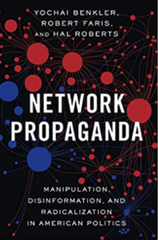
Propaganda
“Communication designed to manipulate a target population by affecting its beliefs, attitudes, or preferences in order to obtain behavior compliant with political goals of the propagandist.” – Benckler, Network Propaganda
Intentional communications
Targeted at a population
Political outcomes

Slide 4

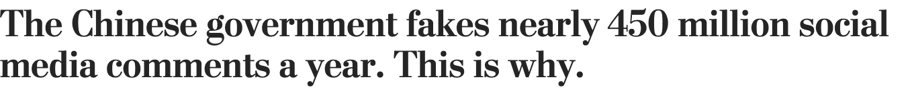
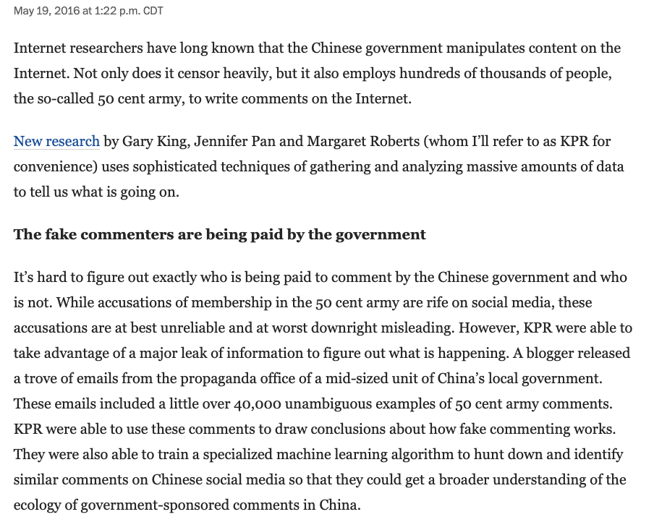
Effects of Propaganda: Induced Misperceptions
Disorientation: Blurring the distinction between fact and fiction.
Distraction: No attempt to engage in debate. Primary purpose is to distract and redirect public attention from discussion or events that could result in collective action.

Slide 5
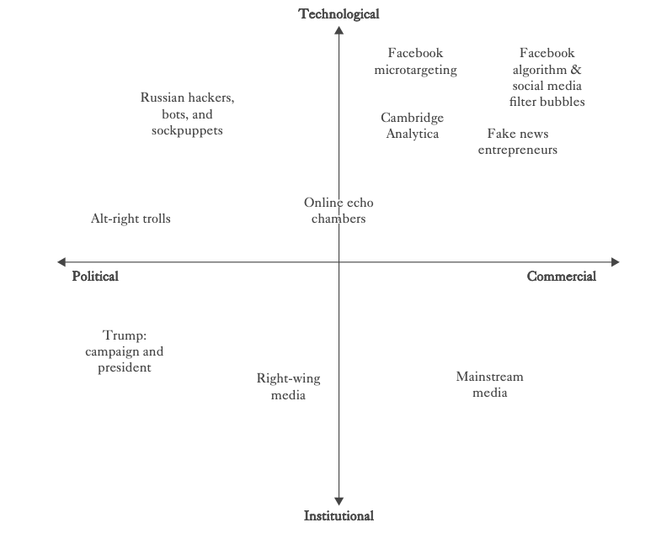

Slide 6
Propaganda and Flooding
Often, blocking access to information can backfire
Blocking access can foment dissent and protest
Citizens may seek access to circumvent the blocking
Alternative strategy: “Flooding”
Create distraction
Change the subject
Make it difficult to find information
China’s “50 cent army” is a good example here, but examples abound everywhere, including the United States

Slide 7
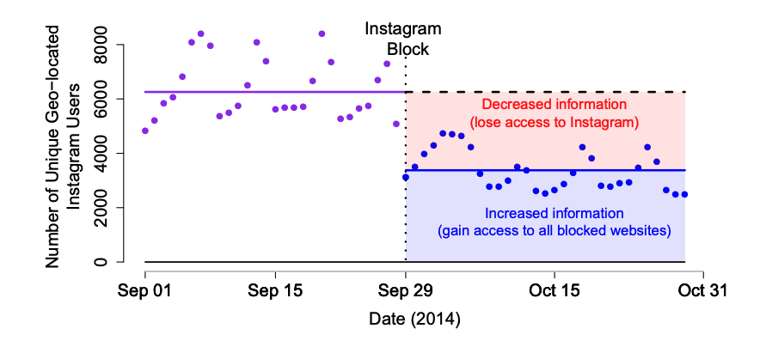
How Blocking Can Backfire: Increased Access
Notes:
The Instagram block led to an approximately 50% decrease in active, geo-located Chinese Instagram users. The x-axis in this figure is the date and the y-axis is the number of unique users on Instagram who added a geo-tagged post to the site that day (a small fraction of all users). We add horizontal lines for the before (purple) and after (blue) Instagram block means of the number of daily, unique, geo-tagging users, as well as the number of these users we would have expected had there been no block (black dotted line). The blue shaded area highlights that 50% of active Chinese Instagram users were accessing an uncensored version of the Internet after Instagram was blocked, while the red shaded area highlights that 50% of Chinese Instagram users were no longer active on Instagram after it was blocked.

Slide 8
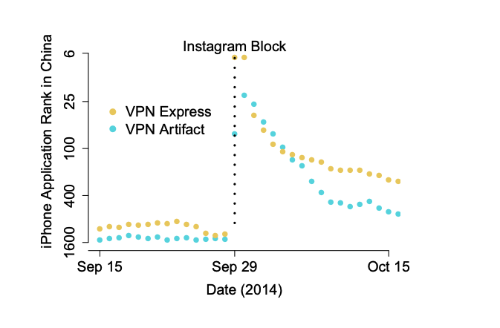
Increased Access via VPNs

Slide 9
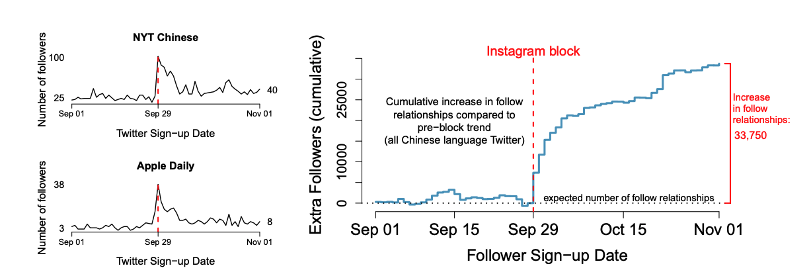
Increase in Access to Blocked Sites

Slide 10
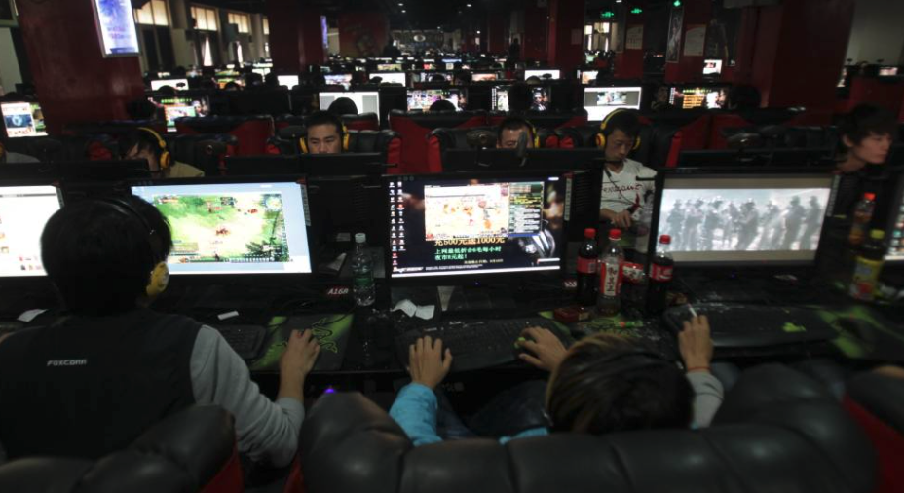
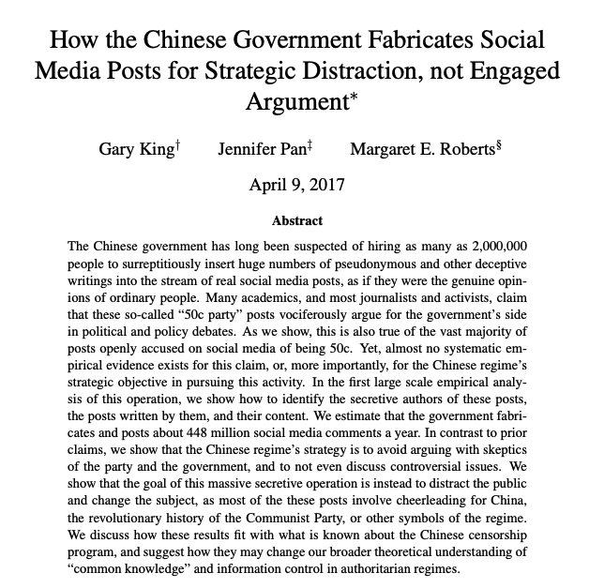

Slide 11
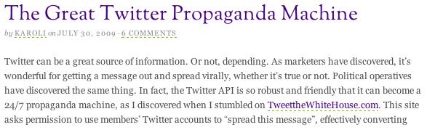
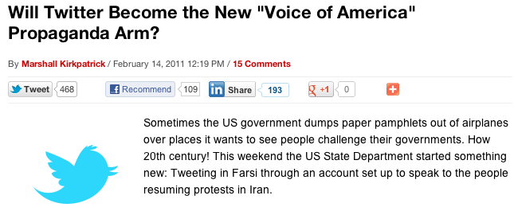
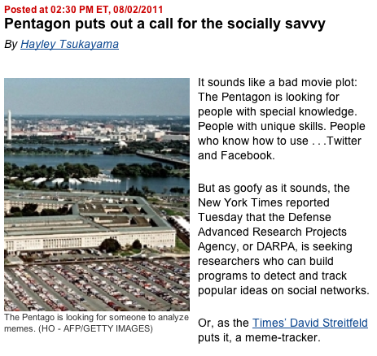
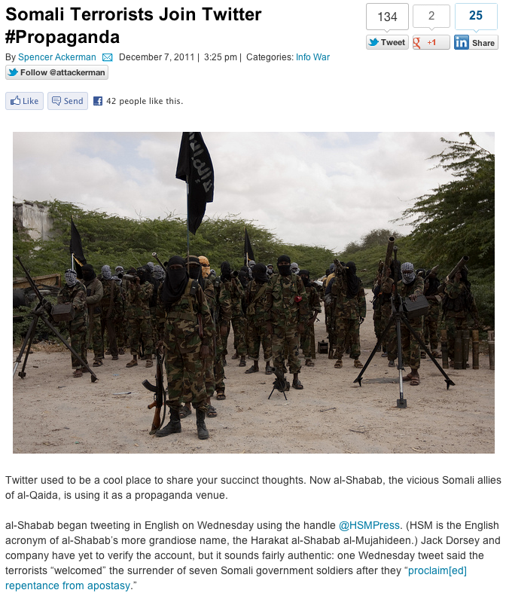
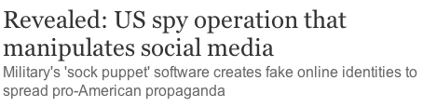

Slide 12


Examples of Distraction
Flooding information to the public
Social media
Pollution of search engine results
Flooding information to the media (press releases)
Tobacco industry (Philip Morris)
Sports (NFL)

Slide 13
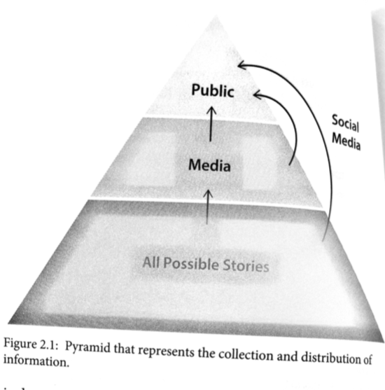
Flooding: Might Be The Most Dangerous Form of Censorship!
It takes advantage of our limited attention span
It is rarely illegal
It can be difficult to identify

Slide 14
Internet Censorship and Online Speech Chapter 9.2: Social Media Behavior of Propagandists
Nick Feamster University of Chicago

Slide 16
Use of Social Media to Spread Propaganda
Social media is an efficient conduit for quickly spreading information to many people.
On Twitter, posting patterns of users who sometimes spread propaganda bear certain hallmarks:
High tweet volume
High ratio of retweets to original content
Short time between original post and retweet
Colluding with other users

Slide 17
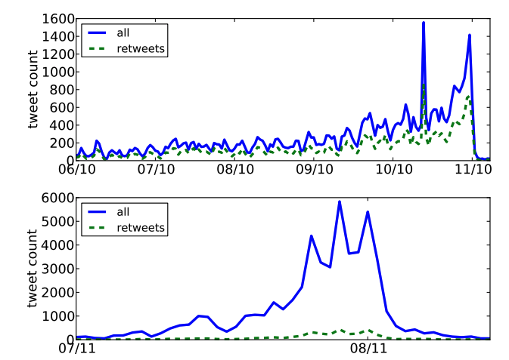
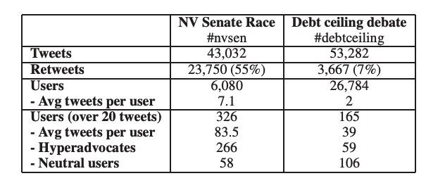
Studying Propaganda

Slide 18
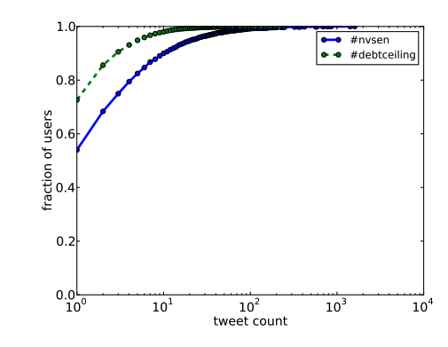
Posts are Highly Skewed Towards a Few Users

Slide 19
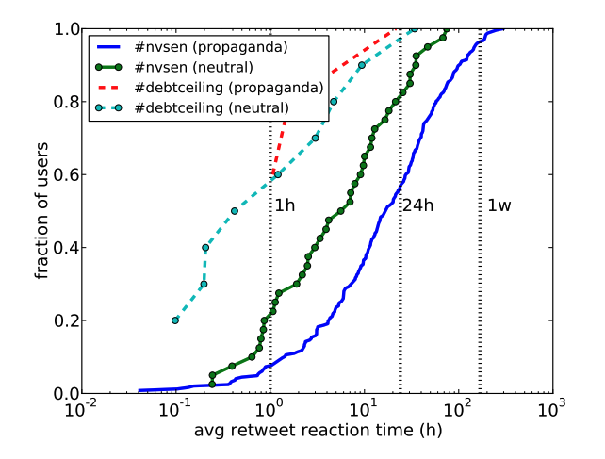
Faster Retweet

Slide 20
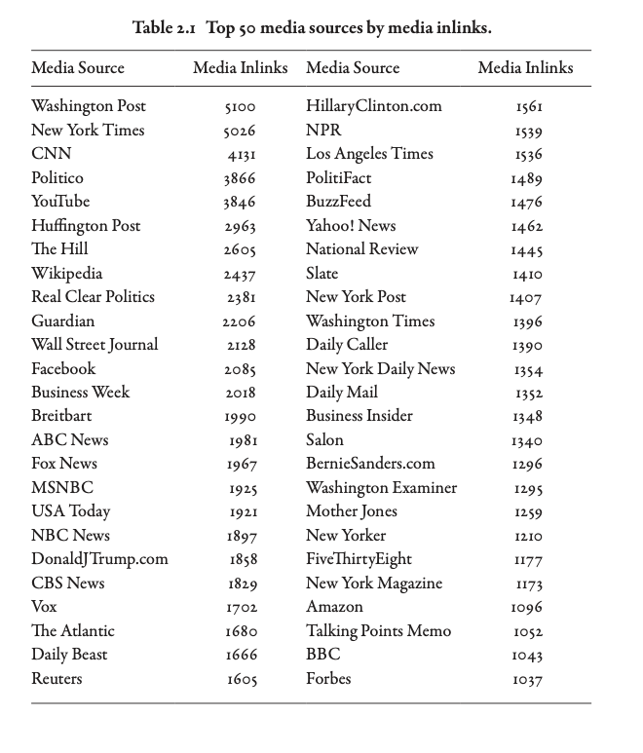
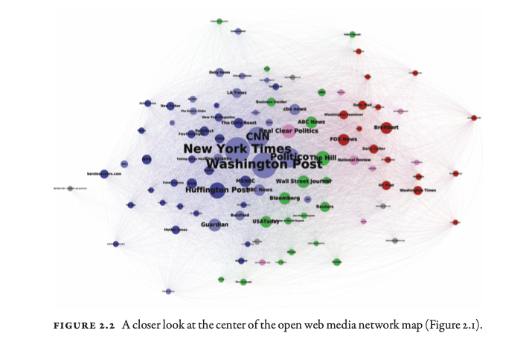
The Media Ecosystem
Notes:
The nodes, or circles, in each map, represent news sources. The size of each node represents its relative prominence by one of three measures. In the open web map, the node size represents the number of media sources that link to a site in the period the map describes. We think of these open-web links as expressions of judgment by online media producers about which sources are more influential as sources to cite. In the Twitter map, the size of the nodes represents the total number of tweets that shared stories from that site. In the Facebook map, the size of the nodes represents the total number of Facebook shares of stories on the site. As a rule of thumb, the sizes on the open web map are mostly determined by thousands of web publishers, those on the Twitter map are determined by millions of tweeters, and those on the Facebook map are determined by tens of millions of Facebook users.

Slide 21
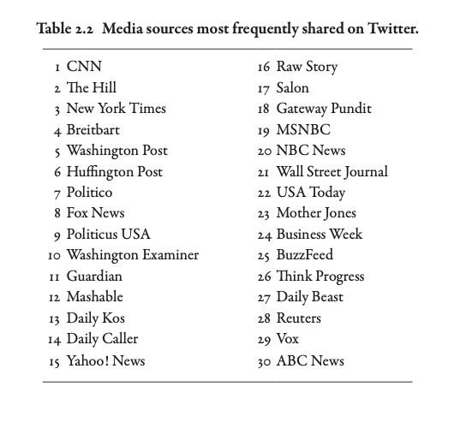
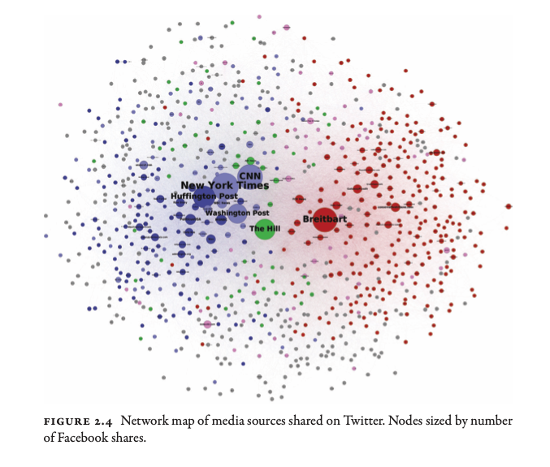
Bots on Social Media: To What Effect?

Slide 22
Summary
Propaganda is an old concept, long pre-dating social media, but social media has lowered the barrier to spreading propaganda
Propaganda on social media dates back (at least) a decade
Over time, the rise of (both automated and human!) bots has exacerbated the problem.
Sometimes propagandists have telltale behaviors.
“Downstream effects” are not completely understood.

Slide 23
Internet Censorship and Online Speech Chapter 9.3: Distraction and Disinformation
Nick Feamster University of Chicago

Slide 24
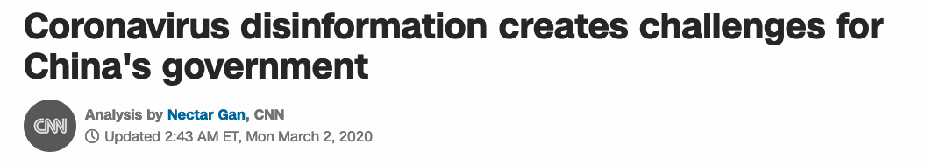
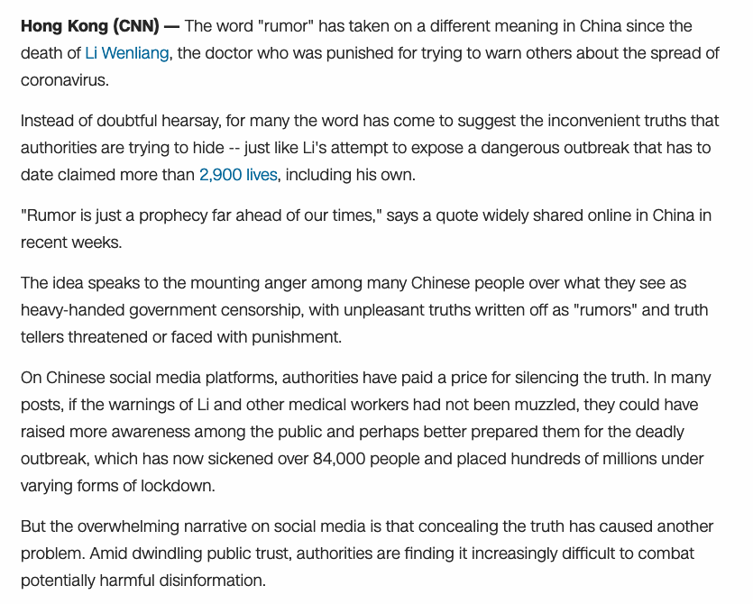
Disinformation: A Growing Problem

Slide 25
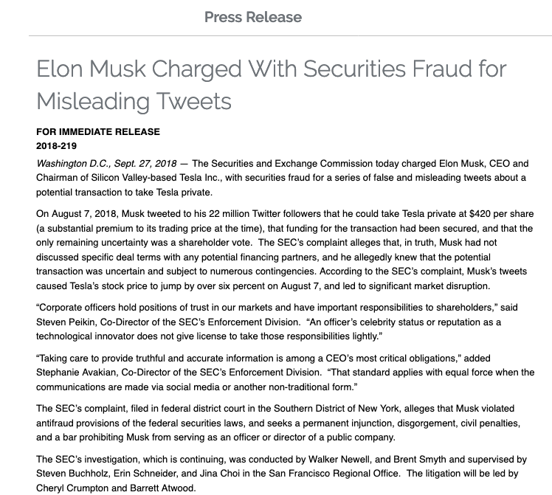

Slide 26
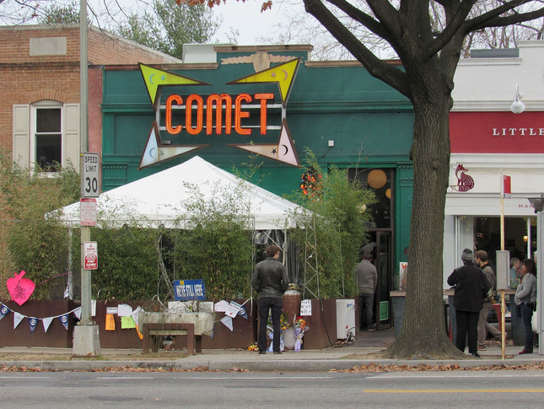
Disinformation Takes Many Forms
Profit-seeking websites (Macedonian clickbait)
Political parties and action committees
Investors, speculators, insiders
Governments

Slide 27
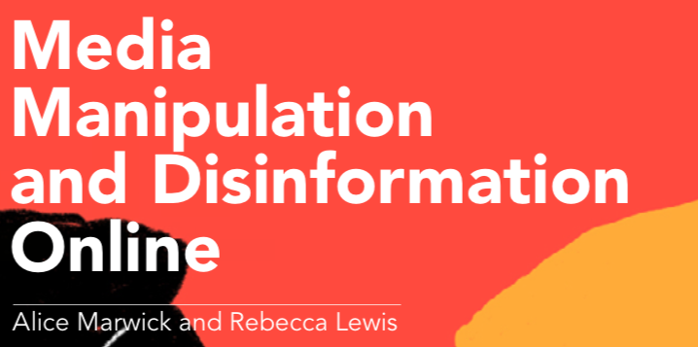
Manipulation of Online Content
Who?
Trolls: Offensive speech, emotional effect, “Poe’s Law”
Hate groups, Conspiracy theorists, …
Where?
Blogs and websites
Forums and message boards
Mainstream social media
Why?
Ideology
Money
Status/Power
How?
Participatory culture
Networks (e.g., channels, hashtags)
Bots
Framing and amplification
Why possible?
Decline of local news/Consolidation
Attention economy (“reporter catnip”)

Slide 28
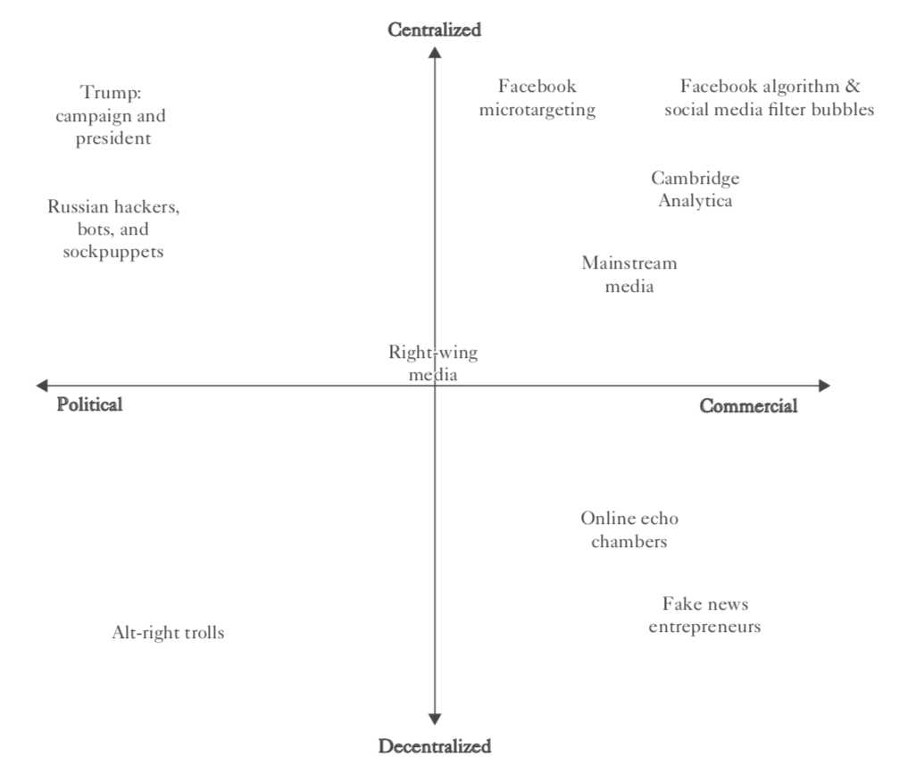
Source: Benkler et al. 2018

Slide 29
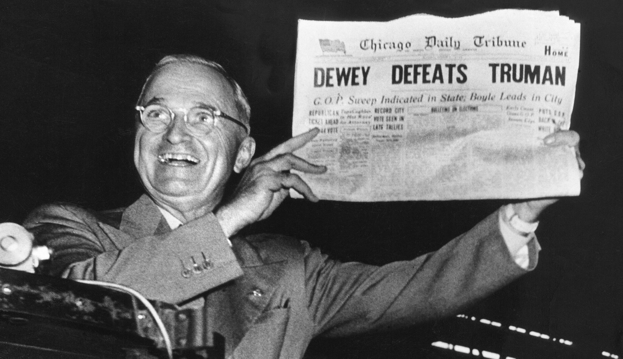
What is Disinformation?
Nonaccidentally misleading information. (Fallis 2015)
Must have information
Must create false beliefs
Must do so intentionally

Slide 30
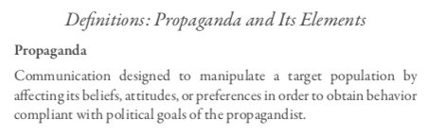
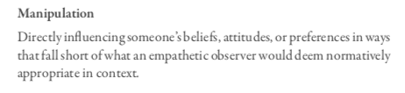
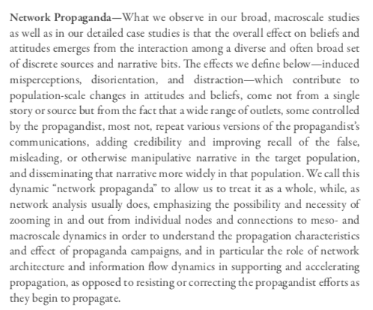
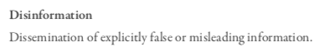
Notes:
But “manipulation” is itself a term requiring definition. By Cass Sunstein’s account, “manipulation” entails influencing people in a manner that “does not sufficiently engage or appeal to their capacity for reflection and deliberation.”49 We think this is too restrictive, because there can be emotional appeals that circumvent the rational capacities but are entirely appropriate for the relevant situation—such as a coach rallying her players’ spirits at halftime after a disastrous first half. The critical issue is appropriateness for the situation.

Slide 31
Effects of Propaganda
Induced misperceptions
Disorientation (inability to tell truth from non-truth)
Distraction (“flooding”, per Roberts)
Source: Benkler et al. 2018
Notes:
Opposing beliefs?

Slide 32
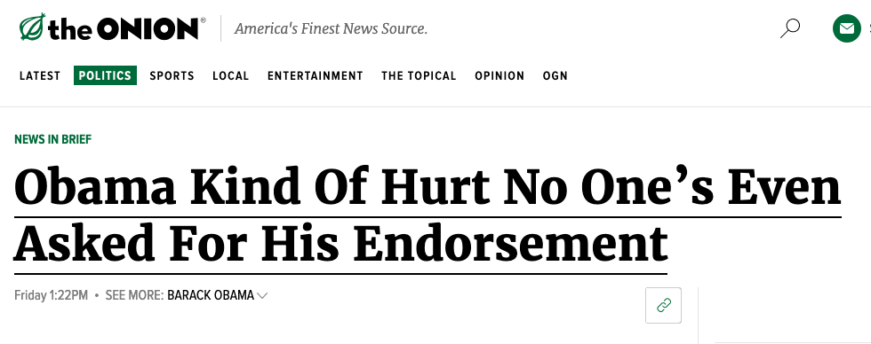
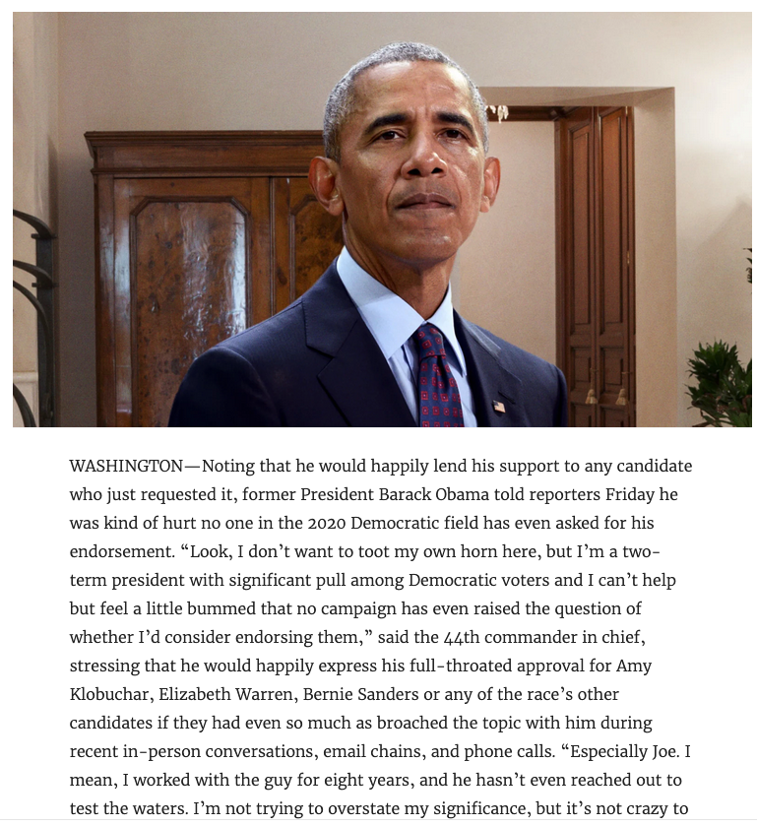
Notes:
Kim Jong Un sexist man of the year example.

Slide 33
Taxonomy of Manipulation
 | Production | Dissemination | Discovery
Changing the choice set | News agencies may choose not to report a story | Social network may remove (or add) content (e.g., Weibo censorship) | Search engine may change the set of results for different users (“filter bubbles”)
Changing the presentation layout (ordering, etc.) | Sites may move content to top/bottom of a page. | News outlets can use social networks to “broadcast” certain stories (e.g., NYTimes Twitter feed) | User profile pollution and poisoning can change the ranking of results
Changing the content | Bogus reviews, “astroturfing”, false Wikipedia entries | “Sock puppets” can create/amplify false content | N/A

Slide 34
Other Examples
Bogus reviews
“sockpuppets”
False wikipedia entries
“astroturfing”
Search-related attacks
Pollution of browsing history
Notes:
Taxonomy in backup slide

Slide 35
Information on the Internet
Influences users’ beliefs and decisions
Economics: buying
Politics: voting
Social world: credibility

Slide 36
Manipulators Target the User
Manipulators target User’s choice set
Manipulators target the attractiveness of different choices
Manipulators falsify content
Notes:
While the possible strategies for information manipulation are theoretically infinite, our project will
create a database of user heuristics and the common manipulation strategies on important applications, as
well as a taxonomy to classify the adversaries and their strategies. Our initial research in this area has
identified three significant, general targets available to the manipulator: (i) changes in the available choice
set, (ii) changes in presentation or layout of information, and (iii) changes in the semantic content of the
information. Changes in (i) the available choice can influence the user’s actions in obvious ways. If a
manipulator eliminates a user’s most preferred option in a list (such as search results), his decision will be
suboptimal. (ii) Perhaps slightly more subtle, changing the order, quality of images or even text quality
can influence the user’s evaluation of information. For example, if a manipulator were able to change
the color of a font to garner a user’s attention, this could lead to suboptimal decisions. (iii) Changes in
the semantic content of information, from outright fabrication to changing the source credentials or friend
recommendations (socket puppeting) of a given choice could lead the user to make a suboptimal choice.

Slide 37
Internet Censorship and Online Speech Chapter 9.4: Detecting Disinformation
Nick Feamster University of Chicago

Slide 38
Detecting Disinformation: Spreading Unwanted Content “Looks Different”
Step 1: Understanding of fundamental behavior
What are the possible invariants?
What mechanisms/infrastructure implements agility?
Step 2: Automating detection
Content is time-consuming, error-prone to analyze
Static blacklists can be outdated, inaccurate
Instead: Identify the infrastructure-level behavior of attackers based on dynamics

Slide 39
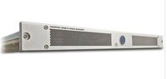
Disinformation is the New Spam
Old Problem: Prevent unwanted traffic from reaching a user’s inbox by distinguishing spam from ham
Question: What features best differentiate spam from legitimate mail?
Content-based filtering: What is in the mail?
IP address of sender: Who is the sender?
Behavioral features: How the mail is sent?

Slide 40
Infrastructure-Based Spam Detection (2009)
Hao, Shuang, et al. "Detecting Spammers with SNARE: Spatio-temporal Network-level Automatic Reputation Engine." USENIX security symposium. Vol. 9. 2009.

Slide 41
Automated Filtering of Spam (2009)
Network-level features to train RuleFit classifier
Comparable performance to manual blacklists
Using only network-level features
Completely automated
Hao, Shuang, et al. "Detecting Spammers with SNARE: Spatio-temporal Network-level Automatic Reputation Engine." USENIX security symposium. Vol. 9. 2009.

Slide 42
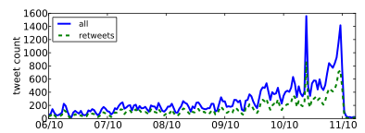
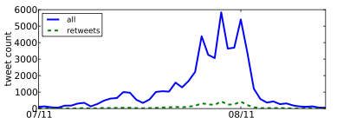
Automated Detection of Propaganda (2012)
Nevada Senate Race
Higher fraction of retweets
More bursty tweeting volumes
Higher daily volumes
Quick retweeting
Debt Ceiling Debate
#bias: Measuring the Tweeting Behavior of Propagandists
by Cristian Lumezanu, Nick Feamster, and Hans Klein.
In the Sixth International AAAI Conference on Weblogs and Social Media (ICWSM), 2012.
Notes:
Note: This study likely no longer works.

Slide 43
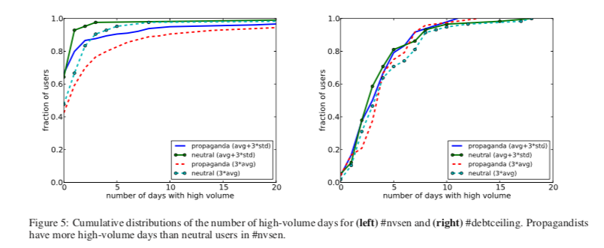
High-Volume Days

Slide 44
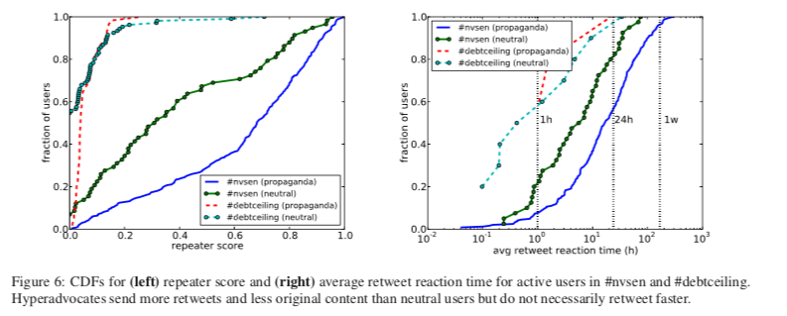
Retweet Fraction and Frequency

Slide 45
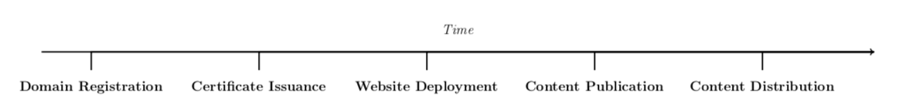
Question: Does Disinformation “Infrastructure” Look Different?
Apply similar ideas to disinformation that were previously effective on spam, phishing, etc.
Look for analogous infrastructure invariants.

Slide 46
Challenges
Defining “disinformation” in the first place
Everything that’s false?
Information that is false but is made to look true?
What about motives? (profit, political, otherwise, …)
Partisan bias is not the same as disinformation
Importance of early detection
Once misinformation spreads, in some sense it may already be too late

Slide 47
Dataset
769 disinformation websites from a combination of sources (FactCheck, Buzzfeed, Snopes, Politifact, Wikipedia, Newsguard)
533 authentic news sites from Amazon Web Information Services (AWIS)

Slide 48
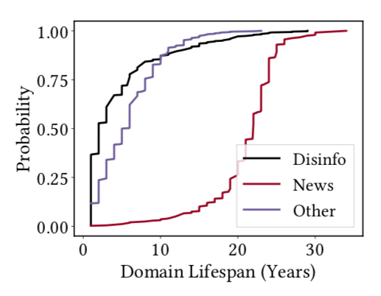
Domain Name Infrastructure
Public websites need domain name / DNS infrastructure
Possible signals
Registrar / Registrant
Registration characteristics (e.g., expiration)
Domain name(s)
Authoritative nameserver

Slide 49
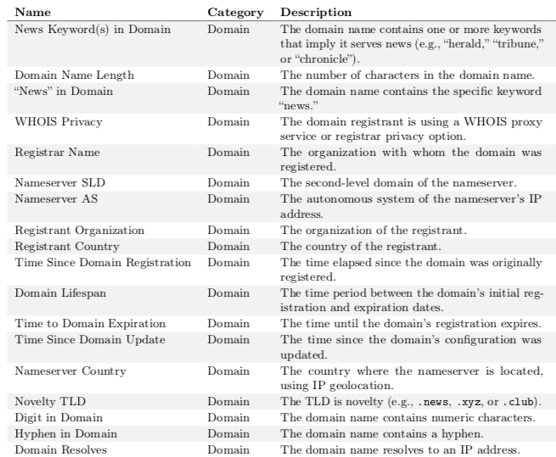
Domain Features

Slide 50
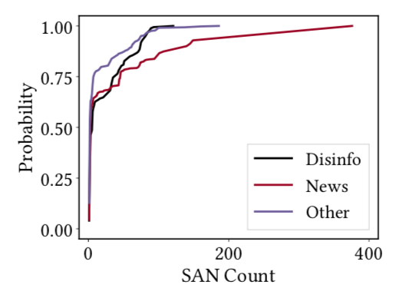
Certificate Infrastructure
Subject Alternate Name (SAN)
Enables sharing a certificate across multiple domain names
Surprise: Legitimate news organizations have long SAN count
Configuration errors
Misconfigured certificates
Unsigned certificates

Slide 51
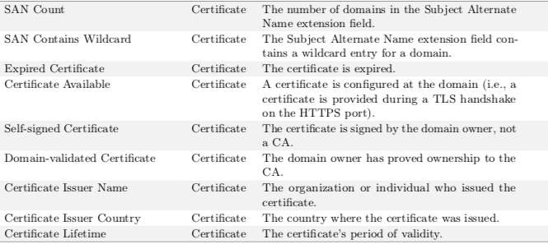
Certificate Features

Slide 52
Hosting Infrastructure
Content management systems (CMS) and plugins
WordPress (82% of disinformation sites, 20% of news sites)
Inexpensive WordPress themes (e.g., mts-best)
Distribution of plugins sufficiently different
Many news sites use custom plugins
Disinformation sites use simple plugins, feedback forms, …

Slide 53
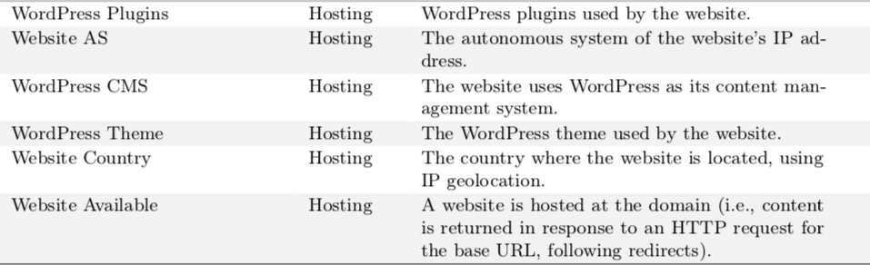
Hosting Features

Slide 54
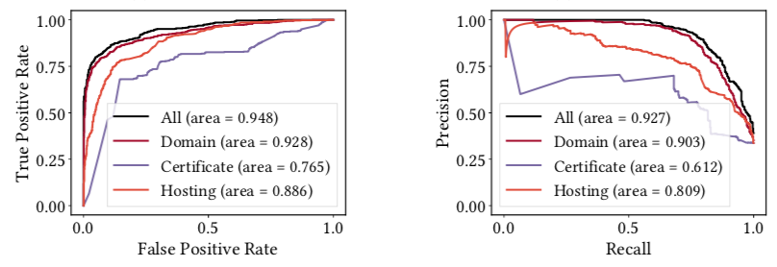
Results: Controlled Experiment

Slide 55
Summary
Infrastructure can a reliable early warning signal for many types of unwanted traffic on the Internet
Demonstrated effectiveness for spam, malware, phishing, web hosting, …
Looking ahead: Detection of infrastructure features to reliably detect disinformation (and perhaps other types of unwanted content) online.

